Slide 1
Unicode essentials
V1.0
By Petar Georgiev

Slide 2
ASCII
ASCII, stands for American Standard Code for Information Interchange
7-bit character code where every single bit represents a unique character
ASCII Table
https://www.ascii-code.com/
Control characters
Printable characters
Extended ASCII table (using 8 bits)
Codes are interpreted according to a Code Page

Slide 3
Codepages
ANSI standard
Codes < 128 => same as ASCII (agreed by all)
Codes > 127 => different meaning, depending on where you live
130 would display as é or 130 would display as Hebrew letter Gimel ג))
These different systems were called code pages
https://en.wikipedia.org/wiki/Code_page
Windows-1252 (ISO 8859-1)
https://en.wikipedia.org/wiki/Windows-1252
Windows-1251 (Cyrillic)
https://en.wikipedia.org/wiki/Windows-1251

Slide 4
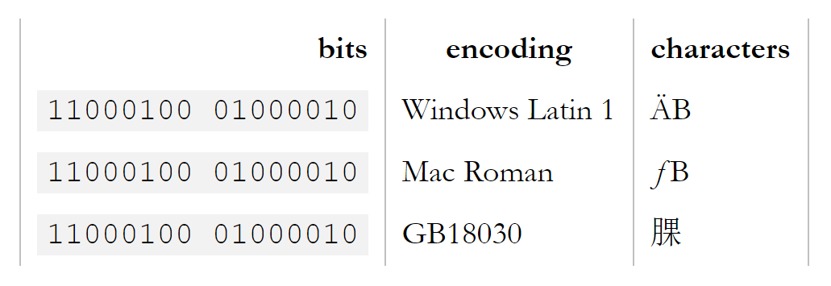
Codepages
Chars with same ASCII codes (> 127) can be displayed as different symbols depending on current codepage

Slide 5
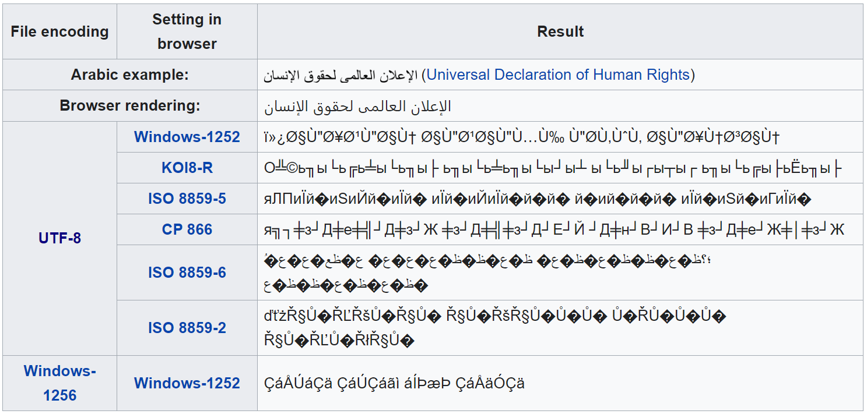
Mojibake
https://en.wikipedia.org/wiki/Mojibake

Slide 6
Unicode
Unicode is an information technology (IT) standard for the consistent encoding, representation, and handling of text expressed in most of the world's writing systems.
https://home.unicode.org/
https://en.wikipedia.org/wiki/Unicode
In Unicode, a letter maps to something called a code point which is still just a theoretical concept. How that code point is represented in memory or on disk is a whole another story.

Slide 7
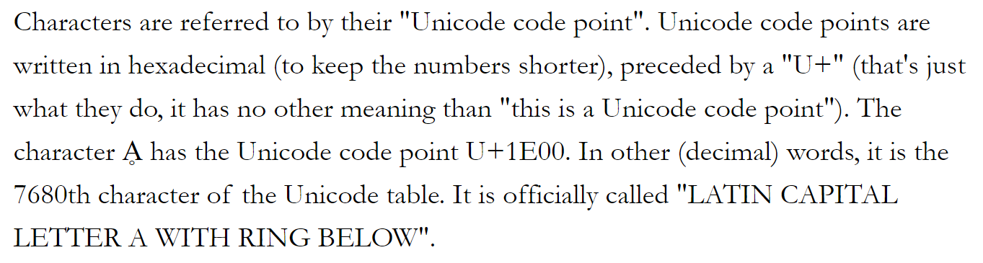
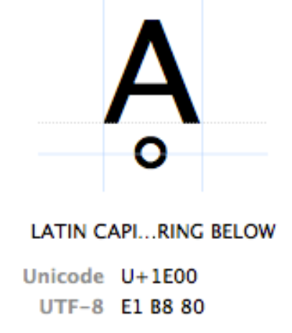
Code points
In Unicode, a letter maps to something called a code point which is still just a theoretical concept. How that code point is represented in memory or on disk is a whole another story.

Slide 8
Unicode encodings
How to represent Unicode codes as bytes?
UTF-32
1 code point == 4 bytes
UTF-16
Multibyte string, variable length
1 code point >= 2 bytes (wide char)
WideStrings
UTF-8
Multibyte string, variable length
1 code point >= 1 byte
Compatible with ASCII
Code page: 65001
In UTF-8, every code point from 0-127 is stored in a single byte. Only code points 128 and above are stored using 2, 3, in fact, up to 6 bytes.

Slide 9
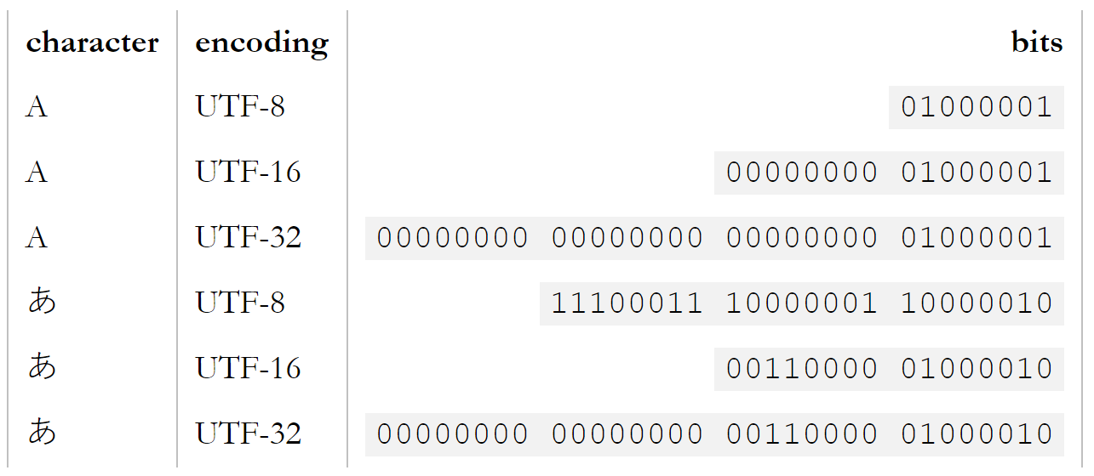
Unicode encodings How characters are being stored in different encodings

Slide 10
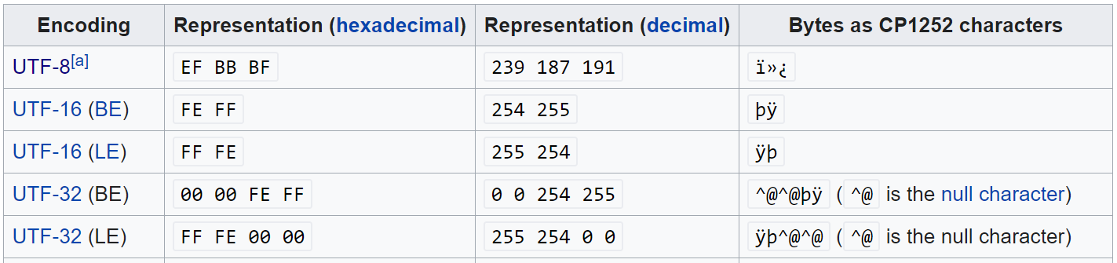
Byte order mark (BOM)
Used to specify the order of bytes in files (UTF-16 & UTF-32)
Big endian (BE)
Little endian (LE)
UTF-8 is single byte encoding
Endianness is not relevant
Easy to detect
UTF-8 BOM should be avoided especially in web pages

Slide 11
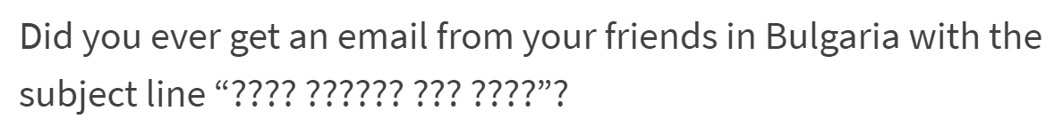
Conversions
ASCII to Unicode
Almost always possible
Unicode to Unicode (UTF-8 to UTF-16, UTF-16 to UTF-8 etc.)
Lossless
Unicode to ASCII
When a character cannot be represented in the character set into which it is being converted, a substitution character is used instead.
Conversions of this type are considered lossy; the original character is lost if it cannot be represented in the destination character set.
? – the char was lost
□ - the char cannot be displayed using current font

Slide 12
Inserting Unicode symbols
HTML
$#N where N is a number in hex or decimal form
U+5408 becomes: &#x5408
MS Word
ALT+ascii_code (should use the numpad to enter ascii codes)
ALT+065 => prints ‘A’
hex_code + ALT + X
typing "1B5" and pressing ALT+X will return the text "Ƶ“
C++
\uHHHH, where H is a hex number
cout << "Hello, ф or \u0444!\n";
JavaScript
var omega = '\u03A9';
C#
var omega = '\u03A9';

Slide 13
Unicode and C++
Strings vs. WideStrings
std::string => 1 char == 1 byte
std::wstring => 1 char == ? bytes
MS compilers – 2 bytes
Other compilers – up to 4 bytes
String literals
L"This string literal is stored as Unicode"
u8"This literal is stored as UTF-8"
std::cout
std::wcout
https://en.wikipedia.org/wiki/C_string_handling#wchar_t

Slide 14
Programmer’s must read links
https://www.joelonsoftware.com/2003/10/08/the-absolute-minimum-every-software-developer-absolutely-positively-must-know-about-unicode-and-character-sets-no-excuses/
https://kunststube.net/encoding/
https://docs.microsoft.com/en-us/windows/win32/intl/unicode-and-character-sets
https://docs.microsoft.com/en-us/archive/msdn-magazine/2016/september/c-unicode-encoding-conversions-with-stl-strings-and-win32-apis
https://support.office.com/en-us/article/insert-ascii-or-unicode-latin-based-symbols-and-characters-d13f58d3-7bcb-44a7-a4d5-972ee12e50e0

